Slide 1
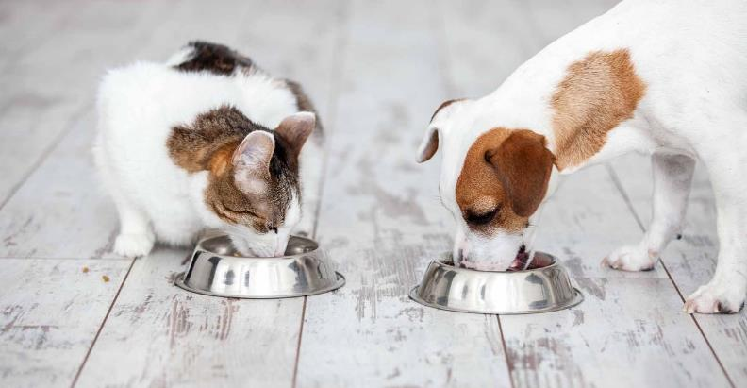
Tomorrow’s pet food solutions today
Increase fresh meat inclusion in dry pet food processing
Bent Ludvigsen
Global Sales & Technology
Alfa Laval Protein Systems
Notes:
Good morning/afternoon. My name is Andriy Revva and I am a Global Sales Manager at Alfa Laval Agro & Protein Systems.

Slide 2

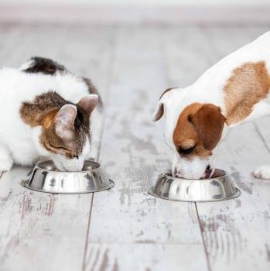
What we will talk about
Agenda
Trends in the dry pet food industry for carnivorous pets
The rendering dilemma from a pet food view
The dry pet food extrusion basics
Alfa Laval solutions for pet food manufacturers
Notes:
Here’s a look at what we will cover today.
Trends in the dry pet food industry for dogs and cats
The rendering dilemma from a pet food view
By-products collected at the slaughtering facility, driven to the rendering facility for drying
Meat and bone meal, added water, extruded and dried again
Far from “food-grade” processing
The basics of dry pet food extrusion
Alfa Laval solutions that will allow better utilisation of meat proteins
Ways to reduce water content
Ways to improve functionality and palatability

Slide 3
Trends in the pet food industry
Notes:
First, lets take a look at the trends shaping the pet food industry.

Slide 4
Global pet food market
Growth in the global pet food market
Global growth of 5% CAGR through 2025
Source: Grand View Research
Notes:
Over the past 20 years, the global pet food market has experienced steady growth.
The market is forecasted to experience a compound annual growth rate of 5% through 2025, climbing to a total of US$113 billion in 2025.
What is not shown on this chart are the main drivers of growth – the biggest gains have occurred – and will continue to occur – with high-end pet foods.
This means that the real area of growth is the premium pet food segment.

Slide 5
Consumer drivers
What’s driving growth in the pet food industry?
Humanization
Pet owners consider pets as family members
Health focus
Pet food selected to meet nutritional needs and safe-guard pet health
Premiumization
Pet owners willing to spend more on pet food with higher quality ingredients
Total transparency
Pet owners want clean labels on pet food, not long lists of complex ingredients
Sustainability and low-impact sources
Pet owners look for natural, locally sourced pet food
Source: Petfoodindustry.com
Notes:
Humanization
Pets are family members and the consumer focus is driven by the change from pet owner to pet parents. T
Health focus
Gentle produced rancid free diets
Nutritional, fresh ingredients
Fresh meat instead of rendered meat
Premiumization buss words:
Authentical Kitchen produced
Gourmet – Natural – Fresh
Protein rich.
Free range
Total transparency
Exactly what are pets fed?
Where is the food made?
Which ingredients?
Sustainability & low impact sources
Fresh meat - locally sourced
Low CO₂ food print
Vegan protein & insect proteins
Pet owners are much more selective about what they feed their furry friends. Let’s look at what’s driving growth in the pet food industry:
Humanization – Pet owners now think of their pets as family members and want to feed them well.
Health focus – Pet owners are conscious of their pets’ diets. They want pet food that meets nutritional needs of their pets while safeguarding pet health.
Premiumization – Premium pet foods have grown in market share. Pet owners are willing to spend more on pet food with higher quality ingredients and high-end packaging.
Total transparency – More pet owners also look for clean labels with simple, healthy ingredients – not long lists with complex ingredients that make it hard to understand what’s in the pet food.
Sustainability and low-impact sources – Pet owners are buying climate-smart pet food with natural ingredients and ingredients that have low impact on the environment (like locally meat by-products and insect proteins).

Slide 6

Processed animal protein
Healthy, sustainable, safe and nutritious by-products
67%
Pet food
1.675 million tons
More meat processing facilities now include pet food production lines
Source: EFPRA, 2021
Notes:
Animal slaughterhouse by-product use.
Here’s an overview of processed animal protein use from the European Fat Processors and Renderers Association. EFPRA represents the European animal by-product industry. In Europe, 2.5 million tons of animal by-products are processed every year into high-protein, low-carbon feed ingredients.
About 25% of all processed animal protein is used as fertilizer.
About 67% of all by-products from slaughterhouses is used in pet food.
The remaining 8% is used in food for human consumption and feed to other animals and fish.
Increasingly, we are seeing that meat processing facilities now include pet food production lines.
But does conventional processed animal proteins meet the expectations of today’s pet owners?

Slide 7
Dry rendering
Notes:
Now let’s look at dry rendering.

Slide 8
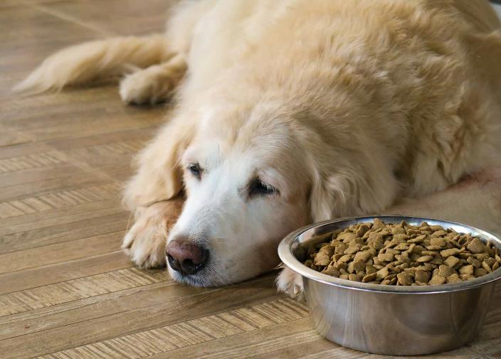
Dry rendering
A simple process with minimum quality concerns
The most common process to transform animal by-products into stable, usable proteins and fat
A very industrial non-sanitary process
Uses significant quantities of energy
Require long processing times
At high temperatures of up to 140°C
Produces brown fat or grease and burnt meal that has undergone oxidation
Notes:
Dry rendering is the most common process to transform animal by-products into stable, usable materials. It separates water, fat and protein components (blood, bone and other meat materials) from animal by-products into dry and stable protein meal and fat for commercial use.
Dry rendering is a very industrial and non-sanitary process.
It uses significant energy quantities.
It requires long processing times at high temperatures of up to 140°C.
It produces brown fat or grease and burnt protein meal that has undergone oxidation.
Although dry and stable, the burnt protein meal and fat are less in line with the trends for high-end pet food.

Slide 9
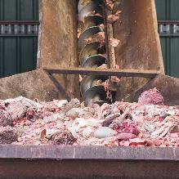
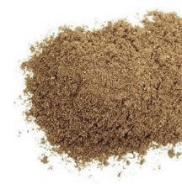
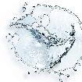
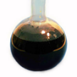
The essence of rendering
Removes water from meat by-products to produce meat meal
Energy
Rendering
Meat by-products
Meat meal
Water
Fat/oil
Notes:
Here is an overview of the basic of a rendering process.
Rendering is a process that reduces a meat by-product by removing water to generate the dry and stable protein meal and fat.
The meat by-products used as raw material going into the process is composed mainly of water (typically up to 68%).
The meat by-products are usually collected from the meat processing facility and driven to a central rendering facility.
The water is removed for discharge through evaporation.
The process uses significant amount of energy (steam).
After rendering, the meat meal contains 65% protein and only 6% water, a higher mineral content, and roughly the same amount of fat.

Slide 10
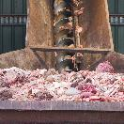
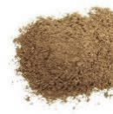
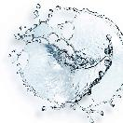
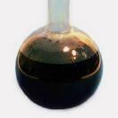
Dry rendering
A simple process with minimum quality concerns
Heating
and
drying
Strainer
Expeller
press
Milling
Grinding meat by-products
Meat and bone meal
Decanter
Separator
Water
Fat/oil
Notes:
The most common rendering methods is dry rendering - a straightforward process with minimum quality concerns. Here’s a flow diagram showing the various stages of a typical dry rendering process..
By-products are ground.
They are then heated and the water is boiled off.
Fat is separated from the protein by mechanical screening (strainer) and pressing (expeller press and decanter) followed by centrifugal separation.
The result is clean fat and meat and bone meal.

Slide 11
Issues with conventional dry rendering
Little to no focus on raw material
Exposed to temperatures up to 140°C
Exposed to air
Process
issues
Thermally damaged proteins
Oxidized product
Low digestibility and potentially carcinogenic
Product
consequences
Highly energy inefficient
Near 1:1 ratio of steam to raw material used
Requires rehydration of meat meal to extrude into dry pet food
Added energy costs and bigger CO₂ footprint
Carbon footprint
and energy costs
CO₂
Notes:
However, dry rendering poses issues.
Conventional dry rendering has little to no focus on the raw material and product quality; the aim is simply to reduce the by-products.
The raw material is exposed to temperatures up to 140°C and it is also exposed to the air.
This has consequences on the end-product.
The proteins may be thermally damaged.
The product can be oxidized.
The crude protein digestibility are low, meaning it is difficult for pets to digest. The high temperatures mean the product can be burnt, exposing pets to potential cancer risks.
What’s more, dry rendering has a large carbon footprint and high energy costs.
It is highly energy inefficient.
It has a ratio of about 1:1 in terms of steam required per kilo of raw material used.
It requires meat meal rehydration to extrude dry pet food.
It has added energy costs and a bigger carbon footprint than other methods (which we will discuss soon).

Slide 12

Statements from premium dry pet food producers
What we hear from successful pet food producers
“Quality comes over price because pet owners are willing to pay”
“Grain-free: 95% of the protein comes from animal sources”
“Fresh meat, poultry or fish are always the lead ingredients”
“Locally sourced”
“Minimally processed, protein-packed diets”
“Two-thirds comes from meat, fish, or poultry sources”
“Saving energy is our focus”
Notes:
Here’s what we hear from successful premium pet food producers:
Quality comes over price because pet owners are willing to pay for it
Fresh or raw meat, poultry or fish are always the lead ingredients
Two-thirds of all ingredients is sourced from meat, fish or poultry
Grain-free – 95% of the protein comes from animal sources not grains
Locally sourced
Minimally processed, protein-packed diets
Saving energy is our focus

Slide 13
Extrusion
Notes:
The extrusion technology is the most common way to produce dry pet foods using meat proteins.
Let’s look now at the basics when extruding pet food.

Slide 14







Cooking extrusion
How to integrate more fresh meat?
Dry ingredients
# 1
# 2
# 3
Meat ingredients
~70% water
Pumpable
wet and dry ingredients
Weighing
M
Water
Conditioner
M
Steam
Steam
Extruder
M
M
Pellet dryer
Pressure and temperature build up
Wet pellets ~20% moisture
Pellets expansion zone
Hot drying air
Cooling air
Temperature
120°C
95°C
Dry pellets
~6% moisture
5°C
1.5–2 minutes
15–20 seconds
10–15 seconds
Time
Notes:
Most dry pet food is made through cooking extrusion.
Dry ingredients are weighed and dosed into the conditioner.
In the conditioner, water is added and starch gelatinized by cooking with steam injection during mixing.
Meat ingredients that typically have a water content of 70% may be added into the conditioner.
The conditioned product is then dosed into the extruder.
Wet and dry pumpable ingredients can be dosed separately into the extruder.
In the extruder, the product temperature is increased through steam and friction up to 120⁰C under pressure.
At the extruder outlet, pellets are pushed out through the extruder dye, where a rotating knife cuts the pellets.
The pressure release causes the pellets to expand as the water evaporates.
The wet pellets are very soft with a typical moisture content of 20 -30%, and must be dried in the pellet dryer.
The result? Dry pellets with a moisture content of 6% and content of maximum 1 kg of fresh meat per kilo of produced dry pet food.

Slide 15
Challenges of extruding pet food with high meat content
How to integrate more fresh meat?
Dry ingredients
# 1
# 2
# 3
Challenges
Varying fat content in the raw material, making balancing the recipe difficult
With varying fat comes varying water composition
Maximum limit to the moisture content for the extruder
High moisture causes pellets to be too soft for drying
Meat ingredients
~70% water
Pumpable
wet and dry ingredients
Weighing
M
Water
Conditioner
M
Steam
Steam
Extruder
M
M
To dryer
Wet pellets
~20% moisture
Notes:
There are many challenges in extruding pet food with high meat content. These include:
The varying fat content in the raw material, which makes balancing the recipe difficult.
And with varying fat content, the water composition varies too.
There is also a maximum limit to the moisture content that the extruder can handle.
The high moisture content of the product after extrusion causes the pellets to become too soft for handling in the dryer.
The industry aims to achieve a nutritional target of two kilos of fresh meat per kilo of dry pet food.

Slide 16
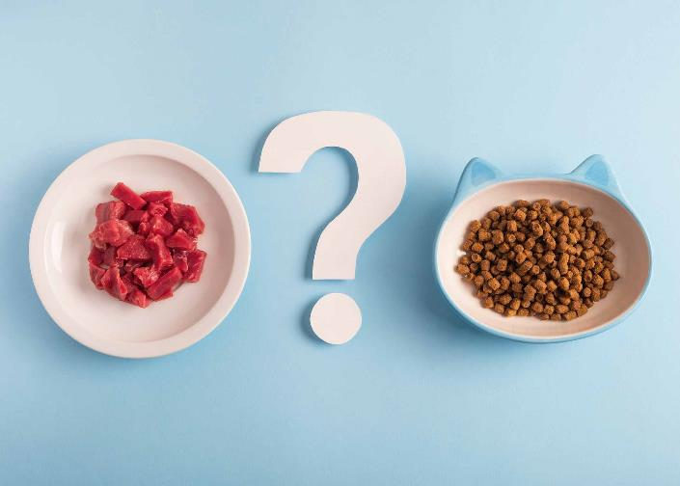
Challenges of extruding high-meat pet food
How to integrate more fresh meat?
Alfa Laval solutions for integrating more fresh meat into pet food
Alfa Laval meat concentration process, including heating, separation and evaporation
Alfa Laval enzymatic process
Notes:
So how can more fresh meat can be included? Is there a way to increase meat enclosure rates from 1 kg to 2 kg?
Two solutions from Alfa Laval may provide a way to integrate more fresh meat into pet food:
The Alfa Laval meat concentration process including heating, separation and evaporation and
The Alfa Laval Hypro process using enzyme technology to process the by-products

Slide 17
Meat concentration
Notes:
First, let’s take a look at the meat concentration process.

Slide 18
Dry rendering compared to wet rendering
More energy efficient, using less steam and less fuel than dry rendering
Dry rendering
~875 kg steam/ton raw material
~62 kg fuel oil/ ton raw material
Wet rendering
~446 kg steam/ton raw material
~32 kg fuel oil/ ton raw material
Grinding
Grinding
Steam
Steam
Heating
Heating and drying
Separation
Meat solids
Water phase
Separation
Evaporation
Steam
Drying
WHE vapours
Milling
Cooling and milling
Meat meal
Fat/oil
Water
Meat meal
Water
Fat/oil
Notes:
In dry rendering, the water is removed by evaporation before the fat is separated. In wet rendering, the separation facilitates a split into moist solids, fat and a water phase with the water-soluble proteins and minerals.
The wet rendering process is more energy efficient than conventional dry rendering, cutting the use of steam and fuel oil by about 50%.
Unlike dry rendering, wet rendering heats the raw materials or meat by-products and then separates fats and solids from the water phase. It also uses evaporation to concentrate solids/water before drying.
It is significantly more energy efficient than dry rendering. As mentioned, this example, reduces steam and fuel consumption by almost half.

Slide 19
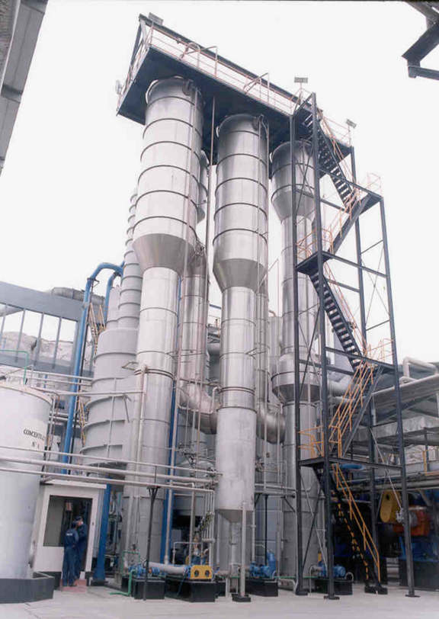
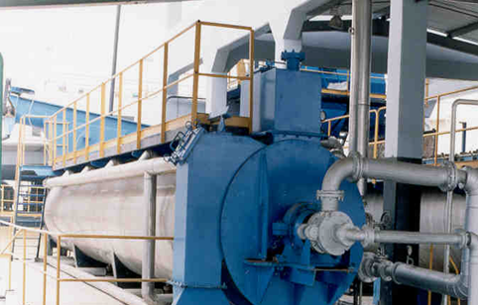
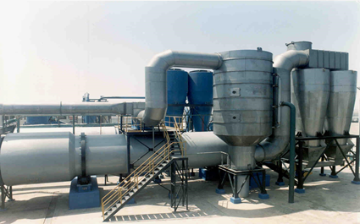
Conventional wet rendering
Challenges
Convention wet rendering challenges
Requires long time at elevated temperatures
Exposes product to air and causes oxidation
Not very hygienic
  Less precise temperature controls
  Large quantities of product left at shutdown
  Not designed for cleaning
Heating
Pressing
Tank storage
Separation
Evaporation and drying
0 ➝ 95°C
75°C
75–90°C
90–95°C
45 ➝ 90°C
Temperature
~30 min.
15 min.
1–2 hours
30 min.
1–2 hours
Time
Notes:
However, the dilemma with conventional wet rendering is:
The process takes a long time at elevated temperatures.
The process temperature is kept just under boiling temperature for 2 – 4 hours.
It exposes the product to air and causes oxidation.
It is not very hygienic:
The temperature controls are not very precise.
There are large quantities of residual product left at shutdown.
It is not easy – in fact, not designed – for cleaning.

Slide 20
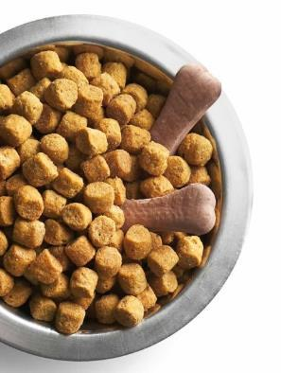
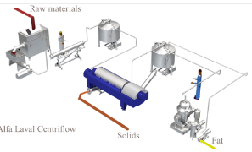
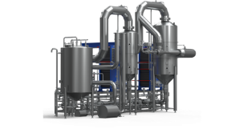
Alfa Laval concentrated meat system
Three process systems in one
Raw materials
Produce a meat concentrate with more meat and 50% less moisture
Raw material grinding and emulsification prepare animal by-products for onward processing
Alfa Laval Centriflow system produces meat solids, stick water and fat
Alfa Laval AlfaVap evaporation system concentrates stick water into a highly functional meat concentrate
Alfa Laval Centriflow
Solids
Fat
Alfa Laval AlfaVap
Notes:
With the Alfa Laval concentrated meat process, there are three process systems in one. It produces a meat concentrate with more meat and 50% less moisture.
First, there’s grinding and emulsification of the fresh or frozen raw material (max 3 mm particle size) for onward processing.
Next is the Alfa Laval Centriflow system, with three-phase decanter centrifuge technology and fat purification to provide meat solids, stick water and fat.
And third is the AlfaVap evaporation system to concentrate the stick water into a highly functional meat concentrate. The concentrate can be used separately as a binder or flavour enhancer in the pellet production stage.

Slide 21




Alfa Laval Centriflow
Innovative continuous wet rendering method for processing soft fatty tissues
Alfa Laval Centriflow
Hygienic food-grade processing equipment
Very precise temperature and time control
Easy to clean
Full Cleaning-in-Place options available
Raw material
Steam
Heater
Intermediate tank
Steam
Decanter
Evaporator
Meat solids
Fat/oil
Concentrate
Notes:
The Alfa Laval Centriflow system is an innovative continuous wet rendering method for processing soft fatty tissues. It is hygienic food-grade processing equipment that offers precise control of temperature and process time – plus it’s easy to clean. An optional Cleaning-in-Place system is available.
The decanter separates the raw material into meat solids and fat/oil. The liquid is sent to an evaporator, the Alfa Laval AlfaVap, to produce a high-flavour meat concentrate.

Slide 22
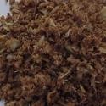




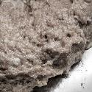
Liquified meat solids
Innovative partial digestion process to ensure meat solids pumpability
Cooling air
Enzymes
Steam
Cooling media
65°C
Meat solids 85°C
Cooling conveyor
Ribbon blender
Semi-viscous
meat solids pump
Contherm for enzyme inactivation
Contherm for
cooling
Pumpable
meat solids
Cooling air
Steam
Cooling media
Notes:
The meat solids from the decanter are not pumpable and must be conveyed.
Alfa Laval has developed a process to liquify the solids phase, using enzymes to convert meat solids to a semi-viscous, pumpable product.
A cooling conveyer reduces the temperature of the decanter solids from 85°C to 65°C.
In a ribbon blender enzymes are introduced into the solids
The enzyme digestion will within approximately 30 min make the solids semi-viscous and pumpable.
Alfa Laval’s Contherm scraped-surface heat exchanger are used to inactivate the enzymes by heating to 90 – 95⁰C.
If required, the meat pulp can be cooled.
This enzymatic processes produces a meat solids pulp that is easy to transport.

Slide 23










Concentrated fresh meat solutions
Enzymatic phase
~340 kg steam/ton raw material
~24 kg fuel oil/ ton raw material
12.5%
steam injection
1.5%
steam injection
AlfaVap evaporator
Water-soluble meat concentrate
Raw material
Direct spark ignition heater
HACCP tank
(Hazard Analysis and Critical Control Points)
Three-phase decanter
Ribbon blender
Contherm for
enzyme inactivation
Pumpable
meat solids
Fat/oil
Grinding
Heating
Tank storage
Separation
Evaporation and enzymatic digestion
0 ➝ 5°C
5–95°C
95°C
95°C
75 ➝ 55°C
Temperature
5–10 minutes
2– 3 minutes
3–5 minutes
~30 minutes
< 30 minutes
Time
Notes:
Unlike dry rendering and conventional wet rendering, the Centriflow concentrated meat process produces two viscous, pumpable products:
Onward processing through the AlfaVap evaporator produces a pumpable water-soluble meat concentrate with high binding properties and excellent flavours
Onward processing through the ribbon blender and Contherm scraped-surface heat exchangers to produce pumpable meat solids
The decanter also separates a third phase – fat/oil – from the raw material.

Slide 24
Improved formulation with concentrated meat
Greater flexibility to handle a wide variety of product compositions
Notes:
The two charts on this slide shows the composition profiles of various raw materials and their change composition after processing.
The Alfa Laval concentrated meat process is flexible and can easily handle varying product compositions. It effectively reduces fat and water content, producing a concentrated meat product with higher solids content – which translates into higher content of fresh meat in the pet food.

Slide 25
Extrusion
Pumpable meat solids, fat/oil, and concentrated meat broth
Ratio of meat proteins to water
= more than 2:1 compared to adding fresh meat
Uses more than 60% less fuel oil consumption to render one ton of raw meat material for pet food compared to dry rendering
Enables 2 kg meat product per kg produced dry pet food yet still maintains sufficient low moisture content to allow drying
Dry ingredients
# 1
# 2
# 3
Pumpable
meat solids
Weighing
Fat/oil
Water-soluble meat concentrate
M
Conditioner
M
Steam
Steam
Extruder
M
M
To dryer
Wet pellets ~20% moisture
Notes:
For extrusion, there are now three ingredients:
Pumpable meat solids
Top quality fat or oil
Concentrated meat broth (the water phase) with high level of flavours and binding capabilities
It is interesting to note that:
The ratio of meat proteins to water is more than 2:1 compared to adding fresh meat.
Extrusion reduces fuel oil consumption by 60% when rendering a ton of raw meat material for pet food compared to dry rendering.
It also enables the use of 2 kg meat product per kg produced dry pet food yet still maintains sufficient low moisture content to allow drying.
This extrusion process produces wet pellets with a moisture content of approximately 20%.

Slide 26
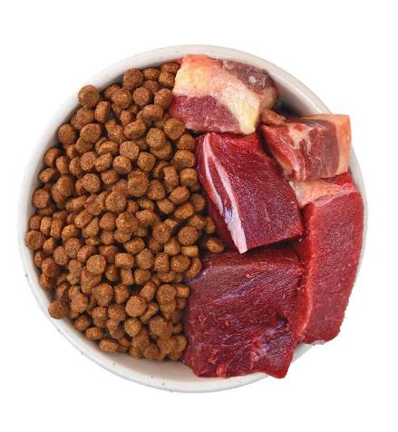
Alfa Laval concentrated fresh meat systems
Benefits
Compared to dry rendering and conventional wet rendering, it is
A very gentle process
Maintains low temperatures
Saves time and requires only 45 minutes
Resulting in
More consistent, high-quality end-product
Easier to formulate – uniform fat and moisture content
Natural properties of water-soluble proteins maintained
Minimal change required to the non-soluble meat solids to make
it pumpable
Energy reduction
Approximately 60% less energy in the transformation of the
meat material for pet food compared to dry rendered product
Notes:
With Alfa Laval concentrated meat systems, more fresh meat ends up in your pet food.
Compared to dry rendering and conventional wet rendering, it is
A very gentle process
Maintains low temperatures
Saves time and requires only 45 minutes
Resulting in:
A more consistent, high-quality end-product that is
Easier to formulate – uniform fat and moisture content
It maintains the natural properties of water-soluble proteins and
Minimal change is required to the non-soluble meat solids to make it pumpable
Energy reduction
The Alfa Laval system also uses about 60% less energy in the transformation of the meat material for pet food compared to a dry rendered product.

Slide 27
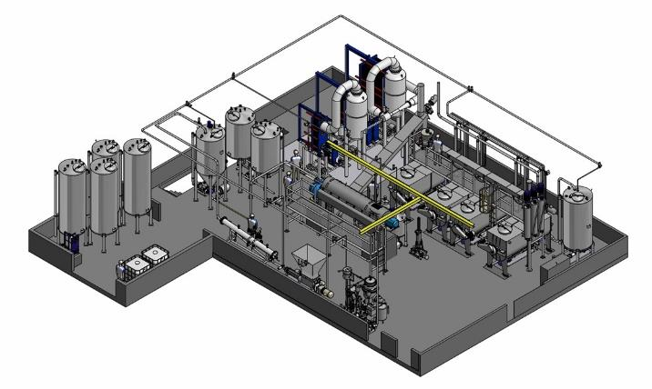
Meat concentrate plant – 10 tonnes per hour capacity
Compact, food-grade installation for dry pet food
Plant capacity:
10 tons per hour
Compact installation
Food-grade standards
Notes:
This is an example of a 10 ton-per-hour raw material plant for meat concentrate production installed at an existing dry pet food company.
It is a compact installation, designed according to food-grade standards.

Slide 28
Hydrolyzation technology
Notes:
Let’s look now at hydrolyzation technology. Alfa Laval offers thermal and enzymatic hydrolyzation systems. We will focus on the enzymatic hydrolyzation here.

Slide 29
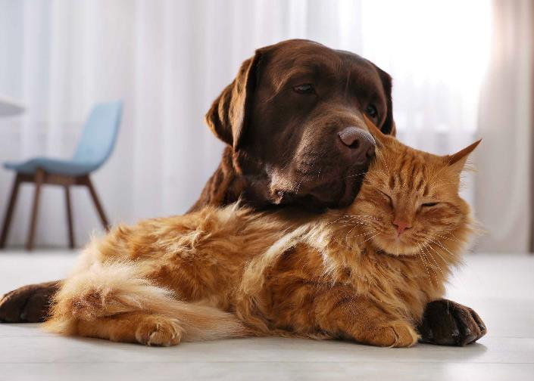
Alfa Laval HyPro enzymatic hydrolysis system
Extracts hydrolyzed proteins through enzymatic digestion
Advantages of enzymatic protein hydrolysis over wet rendering
Produces a protein product with better biological, digestible, and functional properties
Increases product quality and stability due to lower cooking temperature and low oxidation status
Notes:
Why choose enzymatic protein hydrolysis over wet rendering for pet food production? The Alfa Laval HyPro enzymatic system extracts hydrolyzed proteins through enzymatic digestion.
Compared to the wet rendering method, enzymatic protein hydrolysis often produces a protein product with better biological, digestible, and functional properties.
It can also increase product quality and stability due to lower cooking temperature and low oxidation status.

Slide 30
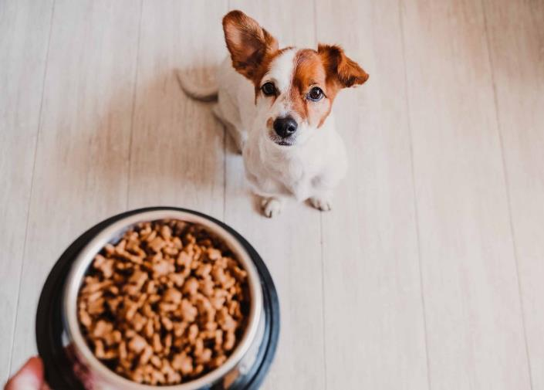
Alfa Laval HyPro enzymatic hydrolysis system
Extracts hydrolyzed proteins through enzymatic digestion
Hydrolysis factors that affect product quality and yield
Substrate type
Enzyme type
Process temperature and pH
Hydrolysis time
Amount of water added
Notes:
Several factors can influence the hydrolysis process and affect product yield and quality. These include substrate type and properties, enzyme type and properties, process temperature and pH, hydrolysis time, and the amount of added water. HyPro provides the control required during processing to extract high-quality proteins and achieve maximum yield.

Slide 31
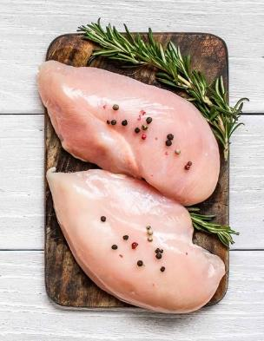
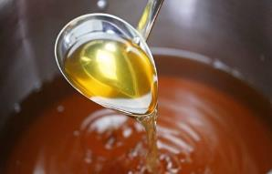
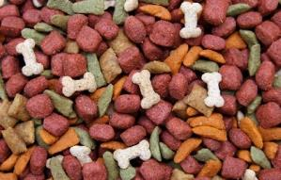
Alfa Laval HyPro enzymatic hydrolysis system
Extracts hydrolyzed proteins through enzymatic digestion
Especially suitable for raw materials with high content of soft tissue
Soups
Flavours
Pet foods
Protein enhancers
13/12/2021
| © Alfa Laval
31 |
Notes:
The Alfa Laval HyPro enzymatic system is especially suitable for processing raw materials with high content of soft tissue. These produce hydrolyzed proteins for use in flavour ingredients in a variety of foodstuffs, including soups, and pet foods. These are also used as protein enhancers and are also a way to reduce the ash content by removing bone material.

Slide 32
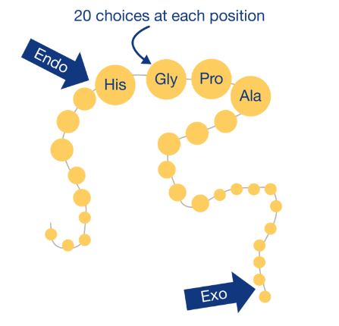
Alfa Laval HyPro enzymatic hydrolysis system
Extracts hydrolyzed proteins through enzymatic digestion
Enzymatic digestion process
Modifies the protein with combination of endoprotease and exopeptidase
Enhanced solubility
Improved emulsifying and foaming characteristics
Better gelation properties
13/12/2021
| © Alfa Laval
32 |
Notes:
How does the enzymatic digestion process work?
Enzymatic hydrolysis break the bonds holding the molecular building blocks within the food together. It uses commercial enzymes, or proteases, to modify and break down bonds in molecules with the addition of the elements of water. Proteins, for example, are broken down into their 'building block' amino acids.
Modifying the protein enhances its solubility, improves its emulsifying and foaming characteristics, and provides better gelation properties.
At each position (His, Gly, Pro, Ala), there are 20 possibilities to modify the protein, providing a broad possibilities to achieve the right hydrolyzed protein for your exact protein requirements.
As mentioned, this results in a higher quality and more stable protein product with better biological, digestible, and functional properties than wet rendering.

Slide 33
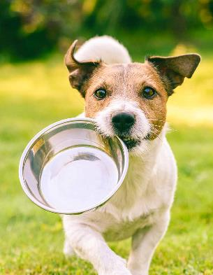
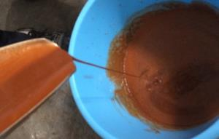
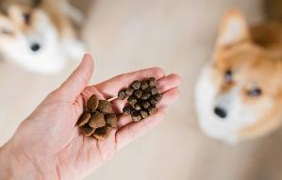
Product of enzymatic treatment
Functional meat extracts
Tastier meat extracts for
pet food
Functional meat extracts
with mild flavours containing relatively large peptides
Extracts with a high flavour intensity consisting of free amino acids
Richer tasting pet food with higher content of functional fresh meat and protein
13/12/2021
| © Alfa Laval
33 |
Notes:
The products of Alfa Laval HyPro enzymatic treatment are functional meat extracts with mild flavours containing relatively large peptides and extracts with a high flavour intensity consisting of free amino acids. These are ideal for use in pet food production for richer tasting pet food with higher content of functional fresh meat and protein.

Slide 34
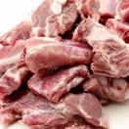


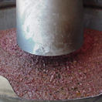

Alfa Laval HyPro enzymatic hydrolysis process
Raw material preparation
Meat detection
Mincing
To digestion
Raw material
Ground solids
Reject
Notes:
Prepping the raw material for the enzymatic hydrolysis process includes meat detection and mincing. This results in ground solids that are forwarded to the digestion process.

Slide 35

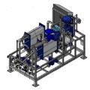

Alfa Laval HyPro enzymatic hydrolysis process
Enzymatic digestion tanks
Hot water
Dosing pump
Enzymes
Steam
Heater for inactivation
Steam
Digestion tank I
Digestion tank II
Digestion tank III
Digestion tank IV
Digestion tank V
Feed
Digest
Notes:
Product is heated to 50 – 60 ⁰C – either by adding hot water or steam injection
The HyPro enzymatic tank design features:
Long and slim tanks
With small volumes – more tanks will provide a more precise digestion profile and less filling and emptying time
An optimized agitator design with Alfa Laval EnSaFoil low shear agitators, special bottom design, and rotation breaker
Hygienic design with CIP cleaning turbines and
An optional heating module to ensure enzyme inactivation is available

Slide 36

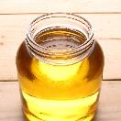




Alfa Laval HyPro enzymatic hydrolysis process
Separation and concentration
Fat/oil
Digest
Oil/fat phase
Refined
product
Purifier
Paddle
refiner
Three-phase decanter
Hydrolyzed protein concentrate
Bones
Water phase
Skimmer
Evaporator
HSS sludge
Decanter sludge
Notes:
The Alfa Laval Hypro includes the following steps:
An optional bone or shell removal step using a paddle refiner.
A three-phase decanter for separation into moist suspended solids, hydrolyzed protein phase, and fat.
An optional purification process of the fat phase to ensure shelf stability.
After the decanter, there is an option to further defat the protein hydrolysate. Here a skimmer centrifuge is used to remove all the light phase.
The AlfaVap evaporation system concentrates the hydrolysate to a highly concentrated phase.
The solids phase from the decanter and the slurry from centrifuges can be mixed with concentrated enzyme digest if desired.

Slide 37
Enzymatic hydrolysis process
Composition compared to meat concentration
Notes:
Looking at the composition profiles again, you see that enzymatic protein digestion provides:
Significant boosts in the ratio of solids/meat protein and drastic reductions in water to just above 40%.
Substantial reductions and stabilization of the fat content.
A ratio of water to meat proteins that is less than one to one.

Slide 38
Extrusion processing
Extruding fat and oil and protein hydrolysates
More meat proteins using
less energy
Only 1/6 of the water of the original meat product
One protein makes balancing with other ingredients easy
Modifying the properties and flavour profile possible
More sustainable processing due to higher energy efficiency
Dry ingredients
# 1
# 2
# 3
Weighing
Fat/oil
Meat protein hydrolysates
M
Water
Conditioner
M
Steam
Steam
Extruder
M
M
To dryer
Wet pellets ~20% moisture
Notes:
The hydrolysed proteins and the separated fats can be used in the pet food formulation and pelletized – achieving:
Only a small amount of water is introduced with the meat proteins. – 1/6 of the water added with the hydrolysed meat protein concentrate compared to a typical fresh meat product.
With only one protein product, it is easy to achieve a good balance with other ingredients.
Plus it’s possible to modify the properties and flavour profile of the meat protein with enzymes.
This translates into more meat proteins in pet food at a much low energy cost!

Slide 39

Summary
Dry product easy to transport
and store
Sourcing unrestricted by limited stability
Often commodity product
Stable fat content
Good digestibility and flavour
Wet rendering
Stable product composition and easy to formulate
Utilization of local raw materials
Very similar product profile compared to using raw meat
Water content is half of fresh meat
Very consistent composition
(fat and water)
Concentrate can be used as binder and flavour ingredient
Little or no addition of water required
Low overall energy consumption in production
Alfa Laval concentrated
meat system
Alfa Laval HyPro
enzymatic hydrolysis system
Very low ratio of water to protein
Possible to adjust mineral content by removing bone ash
Utilization of local raw materials
Flavour and functionality can be altered using different enzyme and digestion profile
Two products only – fat and liquid proteins
Low overall energy consumption
Notes:
Here is an overview of the how to increase the meat content in pet food.
Wet rendering
Dry product that is easy to transport and store
Sourcing unrestricted by limited stability
Often commodity product
Stable fat content
Good digestibility and flavour
Alfa Laval concentrated meat system
Stable product composition and easy to formulate
Utilization of local raw materials
Very similar product profile compared to using raw meat
Water content is half of fresh meat
Very consistent composition (Fat & water)
Concentrate can be used as binder and flavour ingredient
Little or no addition of water required
Low overall energy consumption in production
Alfa Laval HyPro enzymatic hydrolysis system
Very low ratio of water to protein
Possible to adjust mineral content by removing bone ash
Utilization of local raw materials
Flavour and functionality can be altered using different enzyme and digestion profile
Two products only – fat and liquid proteins
Low overall energy consumption

Slide 40
Q&As
Notes:
Let’s open the floor for your questions now.

Slide 41



Questions
Please feel free to contact:
Bent Ludvigsen
Global Sales & Technology
Alfa Laval
bent.ludvigsen@alfalaval.com
+45 28784402
Andriy Revva
Global Sales Manager
Alfa Laval
andriy.revva@alfalaval.com
+45 27778501
Visit our web page for more information
Notes:
Thanks for your time and attention. I’m happy to answer any further questions you may have. Feel free to get in touch with me at any time.

